Slide 1
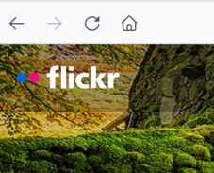
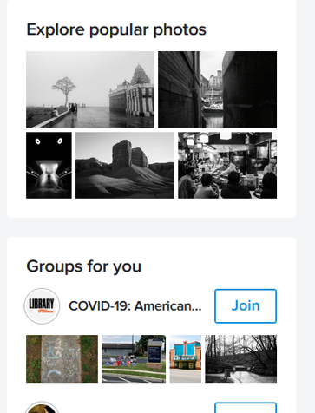
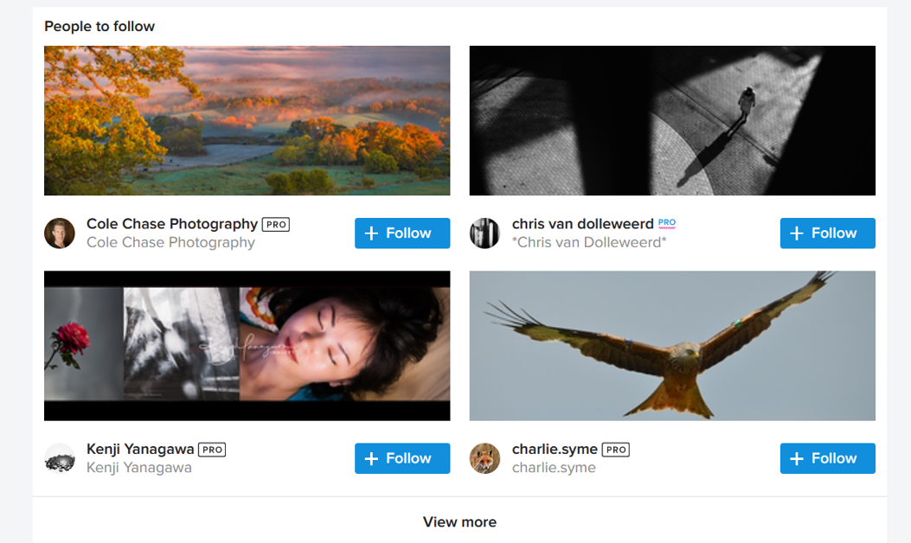
Flickr
The Logo on site is up the top left hand corner.
I have no banner on this site.
I have sprites down the righthand side
The page is full of pictures of a gallery of peoples pictures they have added to the site.

Slide 2
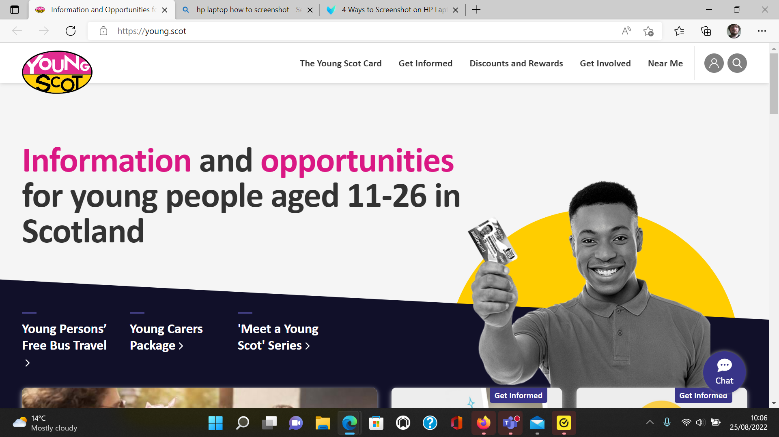
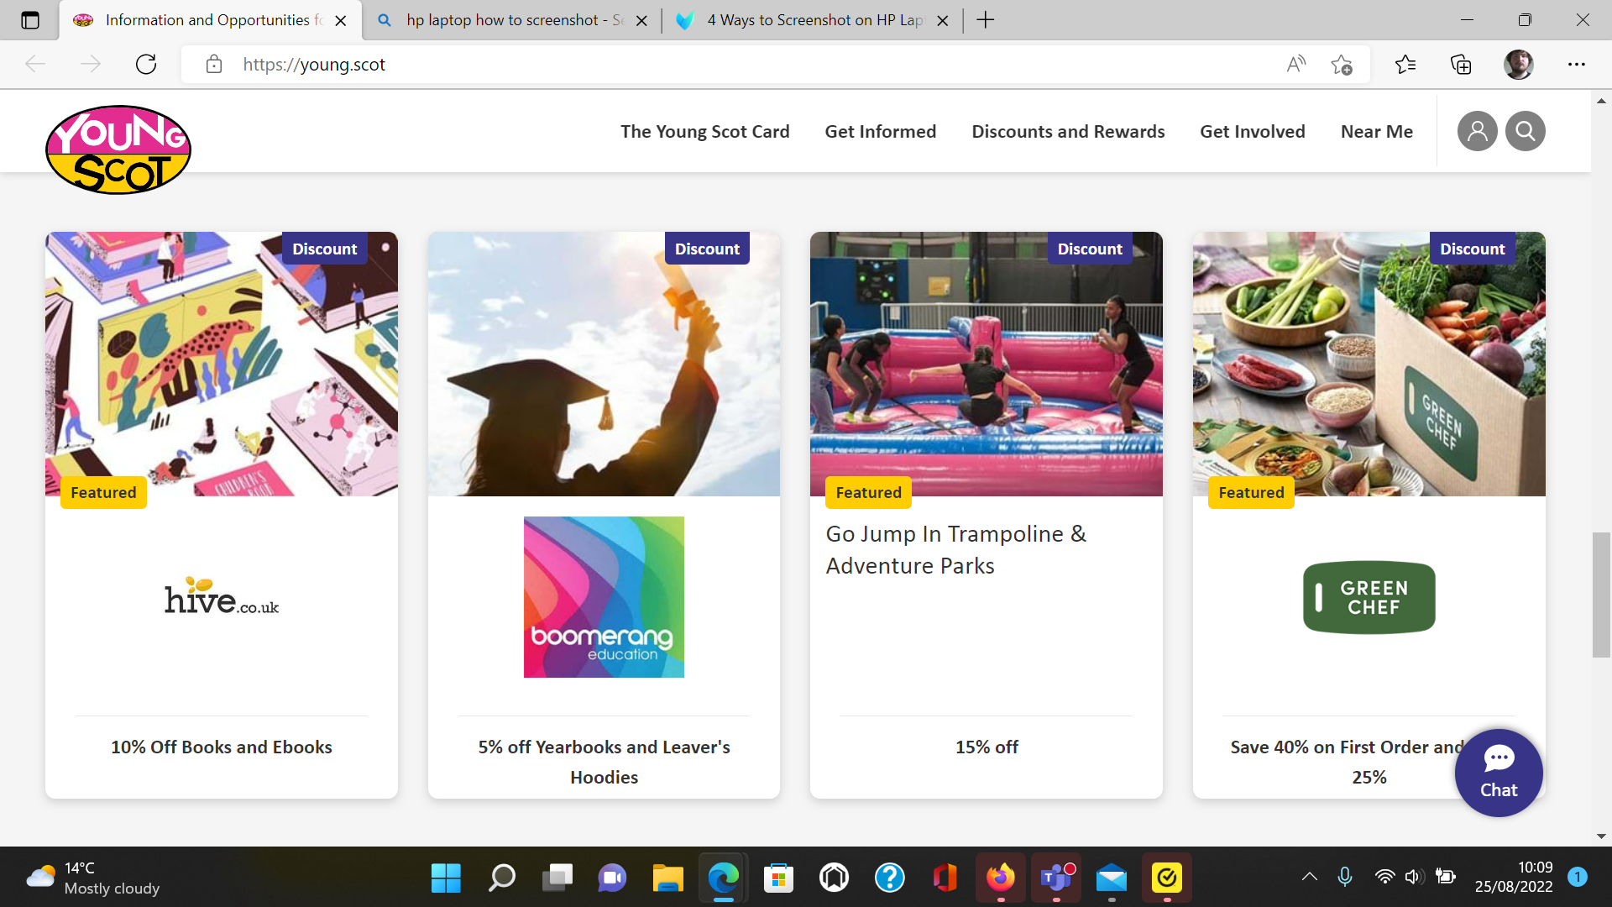
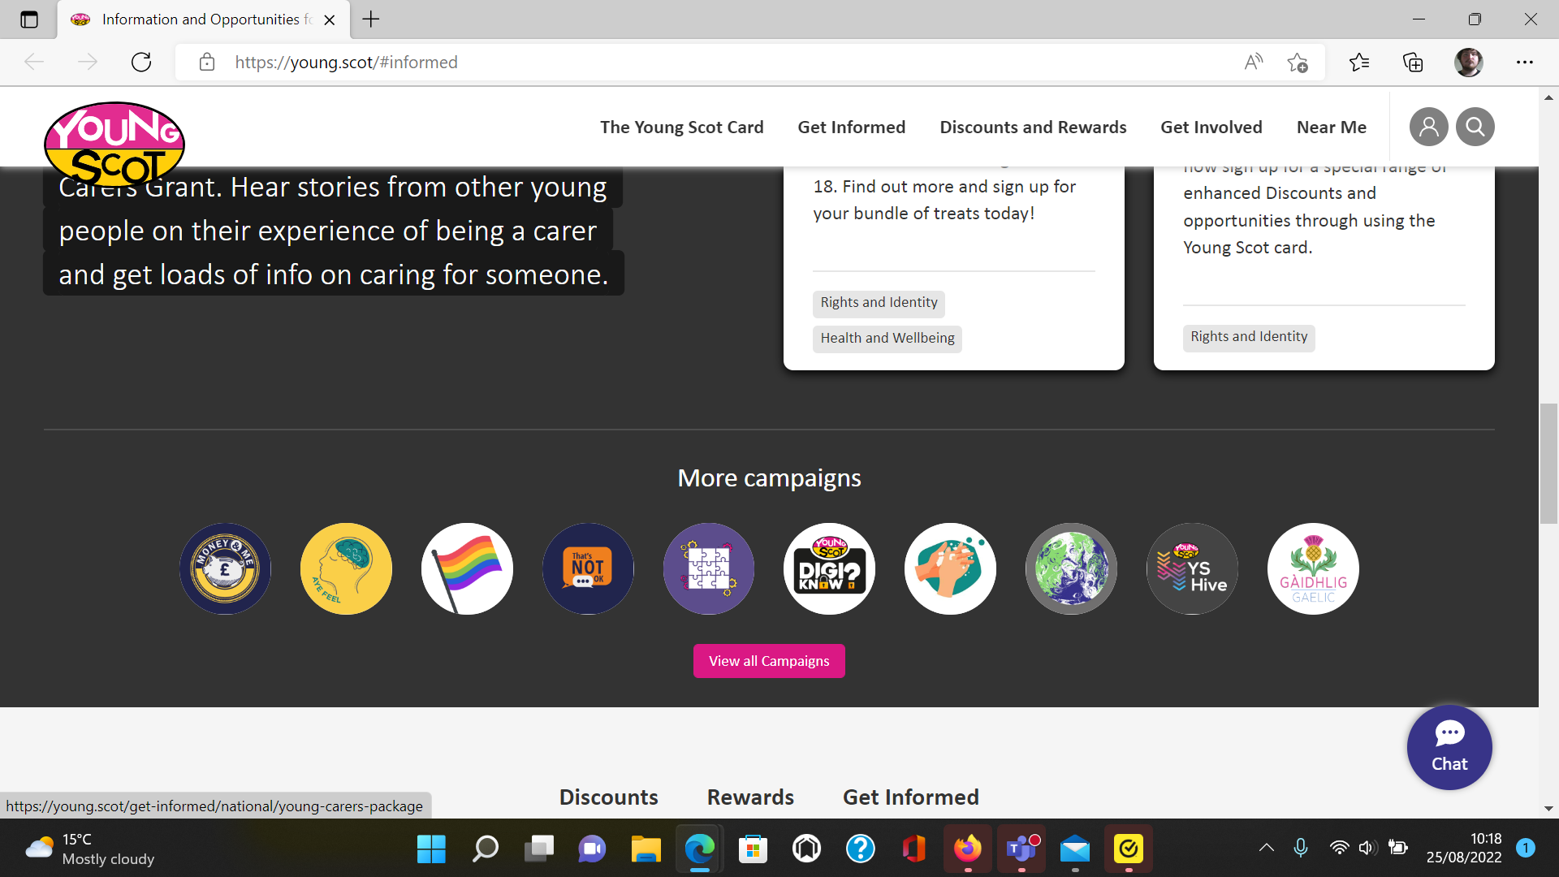
youngscot
Logo is in the top left corner, made to stand out so we recognise the organisation
Banners advertising different services provided. Each service has its own banner
Sprites showing the different campaigns

Slide 3
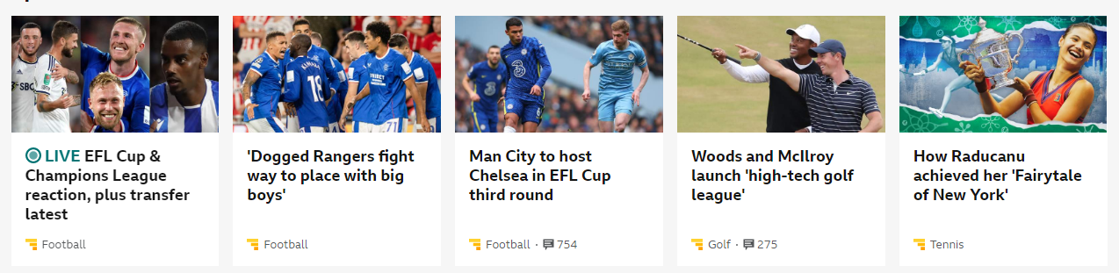

BBC news
Each of the Story on BBC news has their own banner image to support the story and interest readers to look at it.
The logo is an image that should come to mind when you think of the website and is one of the first things on the top of the webpage.
Sprites are multiple images connected into one to reduce the load of lots of images that will only show parts of the image depending on what is used for.

Slide 4

Dumfries and Galloway collage
Logo is at the top of the page with options of find a course' help and advice etc next to it.
Main page has general information with a start date.
Bellow has an option to search for a specific course.
Further down has info on hospitality, business support and other useful info you'll likely need or want with photos that a little insight on the subject.

Slide 5

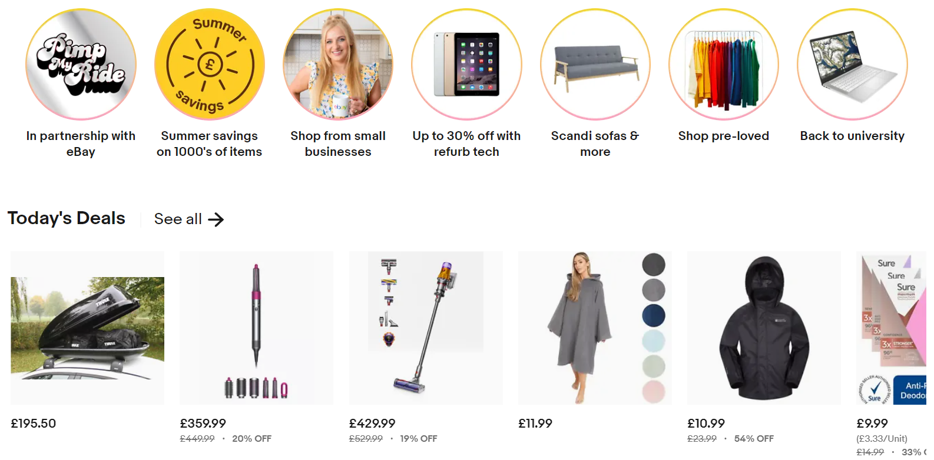
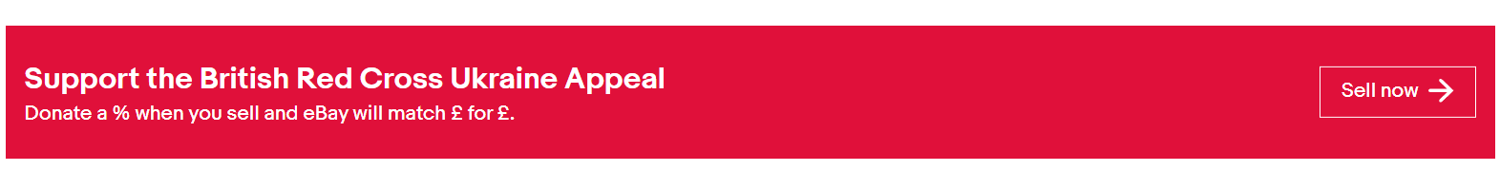
Ebay
The logo is in the top left-hand corner it's made up of bright colours so it can catch your eye when looking about the page.
It is made very clear where you are supposed to go using the page numbers and the arrows.
On the front page it shows different rows of items on display and then with those there are also adverts for other things

